Slide 1
QUIC Protocol
Presenter: AmirMahdi Kousheshi (Dutchman)

Slide 2

How do you make the web faster?
$BROWSER
HTTP/1.1
TLS 1.2
User-perceived latency
TCP
IP
Physical Network
google.com

Slide 3
How do you make the web faster?
$BROWSER
HTTP/1.1
TLS 1.2
User-perceived latency
TCP
IP
Physical Network
Build a carrier-grade network
Google CDN
google.com
google.com

Slide 4
How do you make the web faster?
$BROWSER
Chrome
Launch your own browser
Update HTTP
HTTP/1.1
HTTP/2
TLS 1.2
User-perceived latency
TCP
IP
Physical Network
Build a carrier-grade network
Google CDN
google.com
google.com

Slide 5
How do you make the web faster?
$BROWSER
Chrome
Launch your own browser
Update HTTP
HTTP/1.1
HTTP/2
TLS 1.2
User-perceived latency
TCP
???
Update
transport
IP
Physical Network
Build a carrier-grade network
Google CDN
google.com
google.com

Slide 6
What is QUIC?

Slide 7
QUIC
Quick UDP Internet Connections
A reliable, multiplexed transport over UDP
Always encrypted
Reduces latency
Runs in user-space
Open sourced in Chromium

Slide 8
What is QUIC?
New transport designed to reduce web latency
TCP + TLS + SPDY over UDP
Faster connection establishment than TLS/TCP
0-RTT usually, 1-RTT sometimes
Deals better with packet loss than TCP
Has Stream-level and Connection-level Flow Control
FEC recovery
Multipath
*except for HTTP/2 headers, which should be fixed as well.
Notes:
talk to : rapid deployment on both sides enables us to explore both things like improved congestion and new cool things like semi-reliable transport.

Slide 9
Where does it fit?
HTTP/2
HTTP/2 API
QUIC
TLS 1.2
TCP
UDP
IP

Slide 10
Always encrypted
Comparable to TLS
Perfect forward secrecy, with more efficient handshake
IP spoofing protection
Signed proof of address
Inspired TLS 1.3’s 0-RTT handshake
Plan to adopt TLS 1.3 when complete

Slide 11
Connection establishment
Connection identified by Connection ID
As opposed to common 5-tuple
64 bits
Chosen randomly by the client
Enables connection mobility across IP, port
Notes:
talk to : rapid deployment on both sides enables us to explore both things like improved congestion and new cool things like semi-reliable transport.

Slide 12
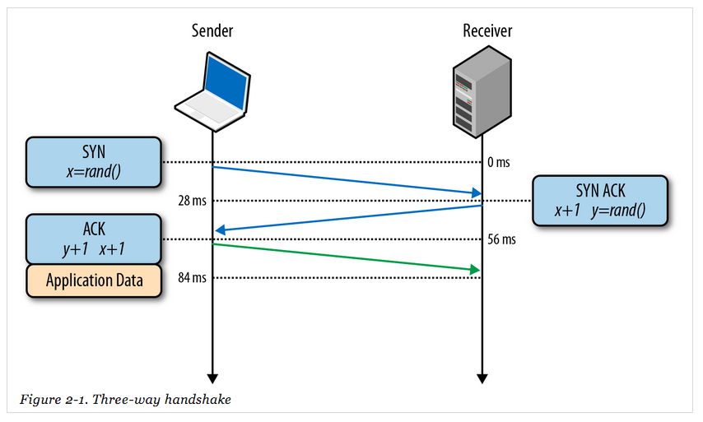
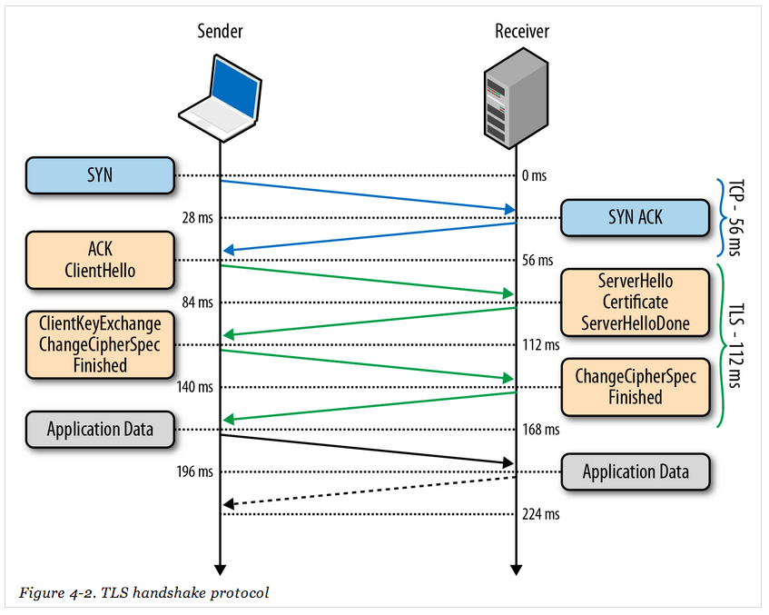
0-RTT connection establishment
TCP
TCP + TLS
QUIC
(equivalent to TCP + TLS)

Slide 13
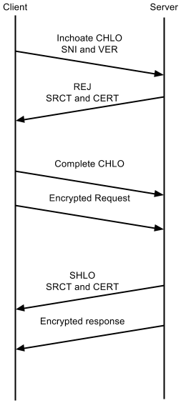
First-ever connection - 1 RTT
No cached information available
First CHLO is inchoate (empty)
Simply includes version and server name
Server responds with REJ
Includes server config, certs, etc
Allows client to make forward progress
Second CHLO is complete
Followed by initially encrypted request data
Server responds with SHLO
Followed immediately by forward-secure encrypted response data

Slide 14
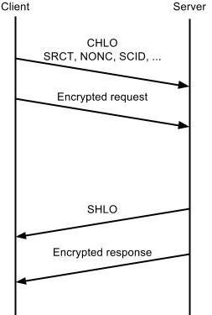
Subsequent connections - 0 RTT
First CHLO is complete
Based on information from previous connection
Followed by initially encrypted data.
Server responds with SHLO
Followed immediately by forward-secure encrypted data

Slide 15
Congestion control & reliability
QUIC builds on decades of experience with TCP
Incorporates TCP best practices
TCP Cubic - fair with TCP
FACK, TLP, F-RTO, Early Retransmit...
More flexibility going forward
Improved congestion feedback, control over acking
Better signaling than TCP

Slide 16


Measuring performance
Controlled Experiments
Client Side
Latency, Bandwidth, Quality of Experience, Errors
Server Side
Latency, Bandwidth, QUIC Success Rate
Fine Grained Analysis
By ASN, Server, OS, Version

Slide 17
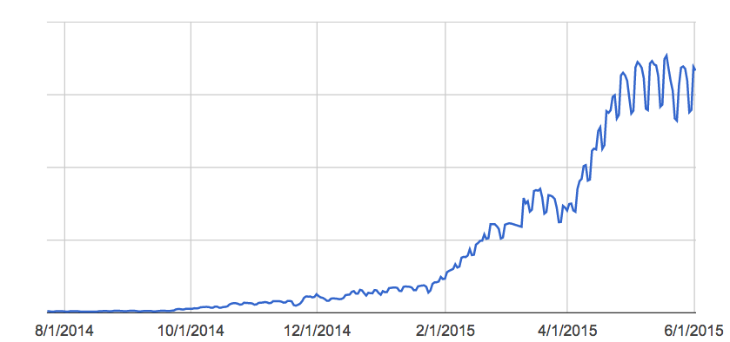
Deployment timeline
Tested at scale, with millions of users
Chrome Canary: June, 2013
Chrome Stable: April, 2014
Ramped up for Google traffic in 2015

Slide 18
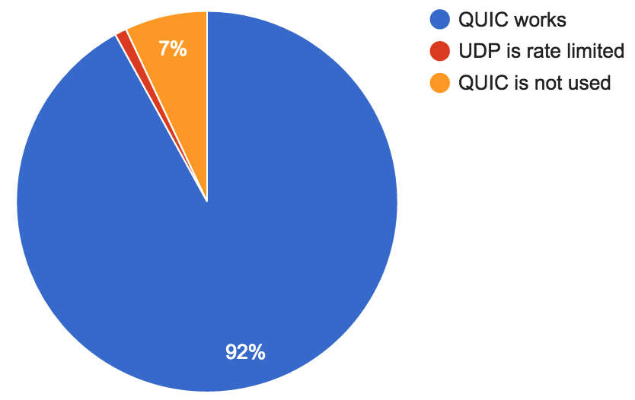
QUIC: Does it work?
QUIC handshakes fail when RTTs are greater than 2.5 seconds or
when UDP is blocked

Slide 19
Performance on Google properties
Faster page loading times
5% faster on average
1 second faster for web search at 99th-percentile
Improved YouTube Quality of Experience
30% fewer rebuffers (video pauses)

Slide 20
Where are the gains from?
0-RTT
Over 50% of the latency improvement (at median and 95th-percentile)
Improved loss recovery
Over 10x fewer timeout based retransmissions improve tail latency and YouTube video rebuffer rates
Other, smaller benefits
e.g. head of line blocking, more efficient framing

Slide 21
Client-side protection
What if UDP is blocked?
Chrome seamlessly falls back to HTTP/TCP
What if the path MTU is too small?
QUIC handshake fails, Chrome falls back to TCP
What if a client doesn’t want to use QUIC?
Chrome flag / administrative policy to disable QUIC
Notes:
UDP Blocked:
Chrome races TCP and QUIC and TCP will win.
Chrome won’t try QUIC for that domain for 5 minutes.
Exponentially back off from there.
Path MTU: QUIC’s handshake packets are a fixed size(1392 bytes) and always the largest packet in a connection.
QoS:

Slide 22
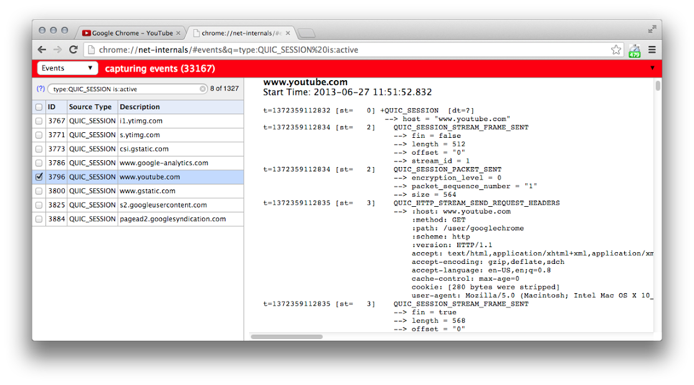
Debugging Tools: Chrome
chrome://net-internals
Active QUIC sessions
Captures all events
Important for filing Chromium bugs

Slide 23
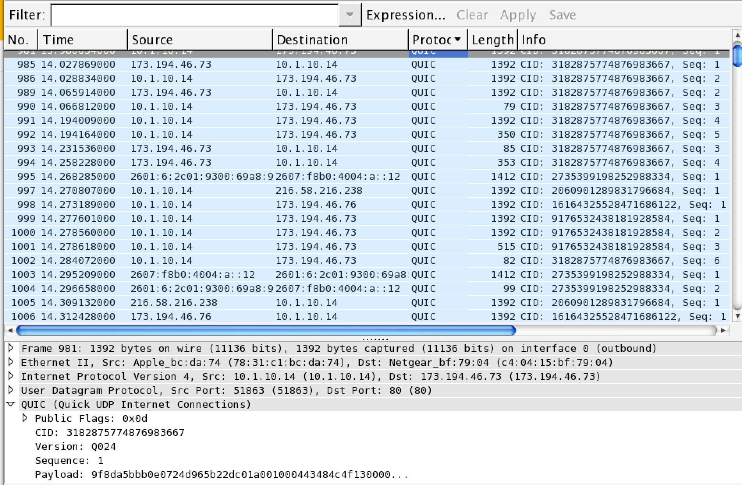
Debugging Tools: Wireshark
Parses
Protocol: QUIC
CID: Connection ID
Seq: Sequence number
Version: ie: Q024
Public flags: 1 byte
Payload: Encrypted

Slide 24
Future Improvements
Forward Error Correction
Connection Mobility
Multipath
More congestion control experiments

Slide 25
Open source implementations
Servers
Open source test server included in Chromium
Working with other server vendors
Clients
Open source Chromium client library for desktop and mobile
Google Chrome and some Google Android apps
Working with other browsers

Slide 26
Review: QUIC Summary
Reliable, multiplexed transport
Runs over UDP
Always encrypted
Lower latency connection establishment
Optional FEC
Rapidly evolving user-space implementation
Open source

Slide 27
QUIC
Source: QUIC in Chromium
Page: www.chromium.org/quic
Any Question?

